Slide 1

Java

Slide 2
What is Java ?
Java is High level Programming language which is Based on the concept of Object oriented.
Its Syntax is most Same like C and C++.
But In java We cannot do the Low level programming like a c and c++.
Java Is Platform:
Java is a platform because it has its own runtime Environment that is JVM(Java Virtual Machine). JVM provides a platform which accepts the byte code and executes on the machine.

Slide 3
History Of Java
Development : James Gosling and his team (Green Team).
Under The Company : Sun Microsystem.(oracle 2010)
Year of Start : 1991.
Java First Name : Oak.
1995 : java alpha Beta Version.
1996 : JDK 1.0

Slide 4
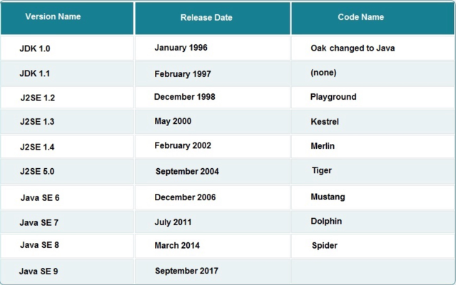
Versions Of Java

Slide 5
Features In Java
Platform Independent (Write Once Run Anywhere).
Portable
Secure
-JVM
-Security Manager
-No Pointer
-Access Modifiers
-Exception Handling
-Own Memory Management
Object oriented
Robust
Multithreading
Simple as Compared to C and C++

Slide 6
Use Of Java
Android Applications
Financial Services industries
Java Web Applications
Software Tools
Big Data Technologies
Scientific Applications
J2ME Applications
Embedded System

Slide 7
What is JDK ?
The Java Development Kit (JDK) is a cross-platformed software development environment that offers a collection of tools and libraries necessary for developing Java-based software applications and applets.
When use JRE?
if you are only interested in running Java programs on your machine then you can easily do it using Java Runtime Environment.
When use JDK ?
if you would like to develop a Java-based software application then along with JRE you may need some additional necessary tools, which is called JDK.

Slide 8
JDK=JRE+DEVLOPMENT TOOLS
JRE
JVM
+Library Classes
+Development Tools
JDK
JDK contains:
Java Runtime Environment (JRE),
An interpreter/loader (Java),
A compiler (javac),
An archiver (jar) and many more.

Slide 9
Hello World Program
Example:
Class Abc
{
public static void main(String args[])
{
System.out.println(“Hello World”);
}
}
We can Declare Number of Classes in a single program.
But In Single java program we can declare only one main public class.
Syntax:
access_modifier class ClassName
{
//Body
}

Slide 10
Changes Acceptable in Main method
Order of Modifiers can be changed.
We can Declare “String[] args” in any acceptable form.
We can give any name instead of “args”
We can use var args instead of String[].
We can use final, synchronized and strictfp with main method.

Slide 11
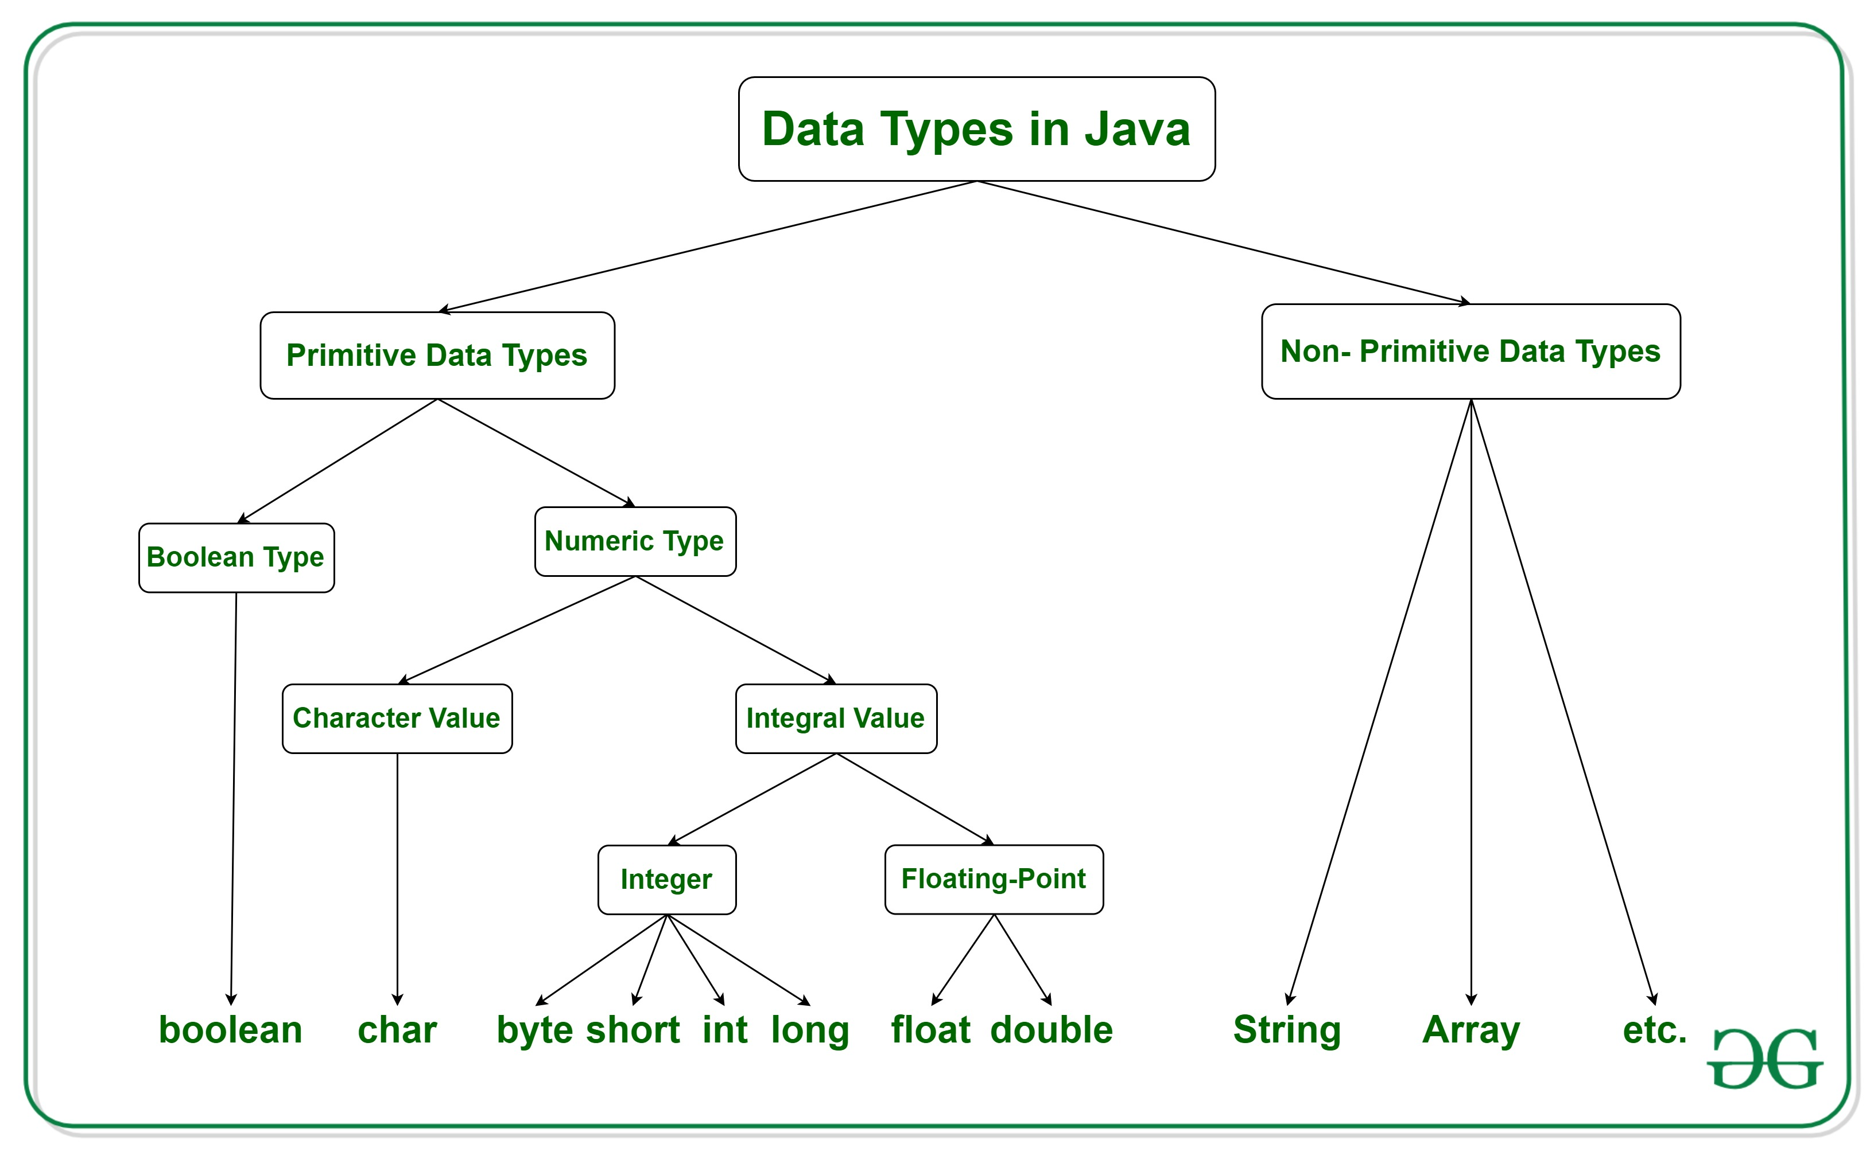
Datatypes
Data types are different sizes and values that can be stored in the variable.

Slide 12
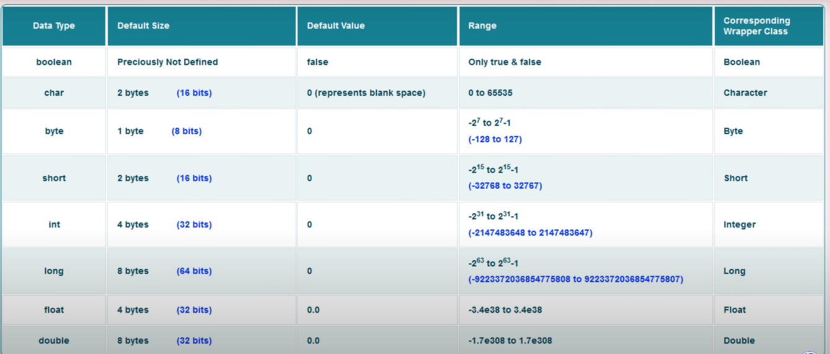
Size and Default values of datatype

Slide 13
Variables in Java
Variable is a name of memory Location that can stored the data.
The value of variable can Vary.
JVM
10
Int a=10;
a

Slide 14
Rules Of Declare a Variable
A variable name can consist of Capital letters A-Z, lowercase letters a-z digits 0-9.
The first character must not be a digit.
Blank spaces cannot be used in variable names.
It allows two special characters such as _ underscore and $ dollar sign.
Java keywords cannot be used as variable names.
Variable names are case-sensitive.
There is no limit on the length of a variable name but by convention, it should be between 4 to 15 chars.
Variable names always should exist on the left-hand side of assignment operators.

Slide 15
Types Of Variable
Instance Variable: Variables which are declare inside the class and outside the method.
Local Variable : Variables Which are declare inside the method .
Static variable : same like instance variable but declare by static keyword and it belongs to class not object
Static variable is also called as Class Variable.

Slide 16
Instance Variables
Declarations : Inside the class but outside methods ,constructors and block.
Scope : Inside all methods, blocks and constructors. But not inside the static method directly.
When Variables Gets Allocated:-When Object is Created variables allocated. Objects gets Destroyed variable releases memory.
Stored Memory : Heap Memory.
Default Values :They have Default values .
Access Specifiers: can be used with Instance Variables.
How to Access:
-Simple method: it can called Directly.
-Static method: We have to called with object reference.

Slide 17
Local Variables
Declarations : Inside methods constructors and block.
Scope : Inside methods constructors and block not outside of them.
When Variables Gets Allocated:-When methods constructors and block get executed variables allocates the memory. -when gets exit , variable destroyed.
Stored Memory : Stack Memory.
Default Values :Doesn’t have any Default value . value should be provided before use.
Access Specifiers: cannot be used with Local Variables.

Slide 18
Static Variables
Declarations : Inside the class with Static keyword but outside methods ,constructors and block.
Scope :Similar to instance variable i.e. Inside all methods, blocks and constructors. But not inside the static method directly. Including static methods, blocks and constructors.
When Variables Gets Allocated:-When we run program and .class file is loaded variable get allocated and vice versa.
Stored Memory :Non-Heap Memory.
Default Values :Similar to instance variable. They have Default values .
Access Specifiers: can be used with Static Variables.
How to Access:
- Directly.
- By using class name.
- By using Object ref. name.

Slide 19
Keywords
Java keywords are also known as reserved words.
Keywords are particular words that act as a key to a code.
These are predefined words by Java so they cannot be used as a variable or object name or class name.

Slide 20
Keywords
abstract | continue | for | new | switch
assert | package | synchronized | default | goto
boolean | do | if | private | this
break | else | import | public | throw
byte | enum | implements | protected | throws
case | double | instanceof | return | transient
catch | extends | int | short | try
char | final | interface | static | void
class | finally | long | strictfp | volatile
const | float | native | super | while

Slide 21
Literals
The Value Assign to a Variable is Known As Literals.
There are many types of Literals. For Ex.
String Literals
Float Literals
Integer literals
Null Literals
Character Literals
Boolean Literals
Operator
Datatype
String name =“Surge”;
Variable
Literal

Slide 22
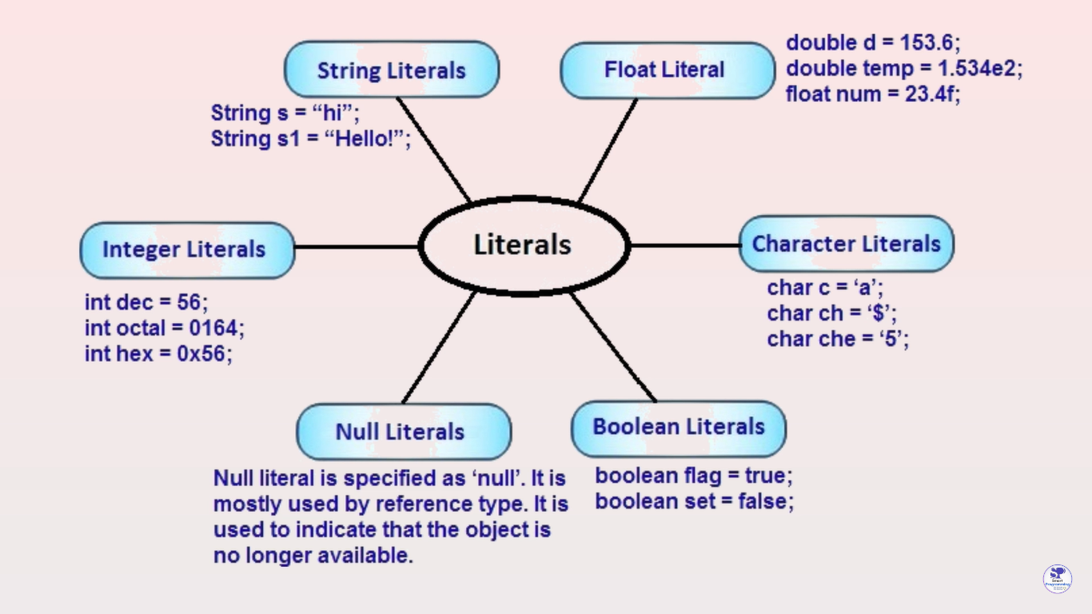
Different Types Of Literals

Slide 23
Identifiers
Identifiers is any name ,it can be Variable name ,method name ,class name or Interface name.
1)class Demo{
//Statement
}
2)int i=20;
3)Interface Test{
//Statement
}
4)public void add()
{
//Statements
}
Identifiers
Identifiers
Identifiers
Identifiers

Slide 24
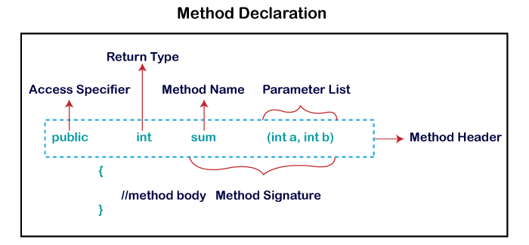
Method Declaration
The method declaration provides information about method attributes, such as visibility, return-type, name, and arguments.

Slide 25
Methods in Java
Definition 1 :a method is a way to perform some task.
Definition 2 : A method is a block of code or collection of statements or a set of code grouped together to perform a certain task or operation.
Similarly, the method in Java is a collection of instructions that performs a specific task.
The method is executed only when we call or invoke it.
Advantages :
It provides the reusability of code.
It also provides the easy modification and readability of code, just by adding or removing a chunk of code.
We can also easily modify code using methods.

Slide 26
Types Of Methods
There are two types of methods in Java:
Predefined Method
User-defined Method
Predefine Method
Predefined methods are the method that is already defined in the Java class libraries is known as predefined methods. It is also known as the standard library method or built-in method.
We can directly use these methods just by calling them in the program at any point.
When we call any of the predefined methods in our program, a series of codes related to the corresponding method runs in the background that is already stored in the library.
Ex. print(),length(), equals(), compareTo(), sqrt(), etc.

Slide 27
2.User-defined Method
The method written by the user or programmer is known as a user-defined method.
These methods are modified according to the requirement.
Syntax : Access_modifier returntype method name(){
//Statement
}

Slide 28
Static Method
A method that has static keyword is known as static method.
Syntax : Access_modifier static returntype method name(){
//Statement
}
In other words, a method that belongs to a class rather than an instance of a class is known as a static method.
We can also create a static method by using the keyword static before the method name.
It is invoked by using the class name.
The best example of a static method is the main() method.

Slide 29
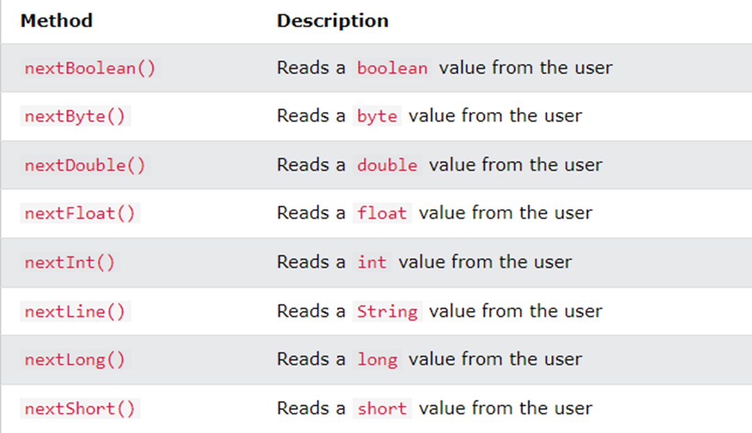
Scanner class
The Scanner class is used to get user input, and it is found in the java.util package.
To use the Scanner class, create an object of the class and use any of the available methods found in the Scanner class documentation.

Slide 30
Constructor
Constructor is a Block (Similar to method) having same name as that of class name.
Constructor does not have any return type ,not even ‘void’.
Only 4 modifiers are applicable for constructor i.e. public, protected, default & private (Static ,synchronized etc we cannot used with constructors).
Constructor executes automatically when we create an object.
Use Of Constructor :
Constructor is used to initialize an object (not to Create Object).

Slide 31
Types Of constructor
There are Three Types Of Constructor:
Default Constructor or no-arg constructor (Create by Compiler)
No-arg Constructor (create by programmer).
Parameterized (create by programmer).

Slide 32
this keyword in java
this is a reference variable that refers to the current object.
this
refer
State
Behavior
Reference Variable
Object

Slide 33
Usage of Java this keyword
this can be used to refer current class instance variable.
this can be used to invoke current class method.
this() can be used to invoke current class constructor.
this can be used to pass as an argument in the method call.
this can be used to pass as argument in the constructor call.
this keyword can be used to return current class instance.

Slide 34
Operators Operator in Java is a symbol that is used to perform operations. For example: +, -, *, / etc.
1.Arithmetic Operators :They are used to perform simple arithmetic operations on primitive data types.
Java arithmetic operators are used to perform addition, subtraction, multiplication, and division. They act as basic mathematical operations.
* : Multiplication
/ : Division
% : Modulo
+ : Addition
– : Subtraction

Slide 35
2.Logical operators
Logical operators are used to determine the logic between variables or values:
Operator | Name | Description | Example
&& | Logical and | Returns true if both statements are true | x < 5 && x < 10
|| | Logical or | Returns true if one of the statements is true | x < 5 || x < 4
! | Logical not | Reverse the result, returns false if the result is true | !(x < 5 && x < 10)
A | B | A&&B | A||B
0 | 0 | 0 | 0
0 | 1 | 0 | 1
1 | 0 | 0 | 1
1 | 1 | 1 | 1
A | !A
0 | 1
1 | 0

Slide 36
3. Bitwise Operators
Bitwise operators are used to performing the manipulation of individual bits of a number.
Operator | Name | Description | Example
& | Bitwise and | Returns true if both statements are true | x < 5 & x < 10
| | Bitwise or | Returns true if one of the statements is true | x < 5 | x < 4
A | B | A&B | A|B
0 | 0 | 0 | 0
0 | 1 | 0 | 1
1 | 0 | 0 | 1
1 | 1 | 1 | 1

Slide 37
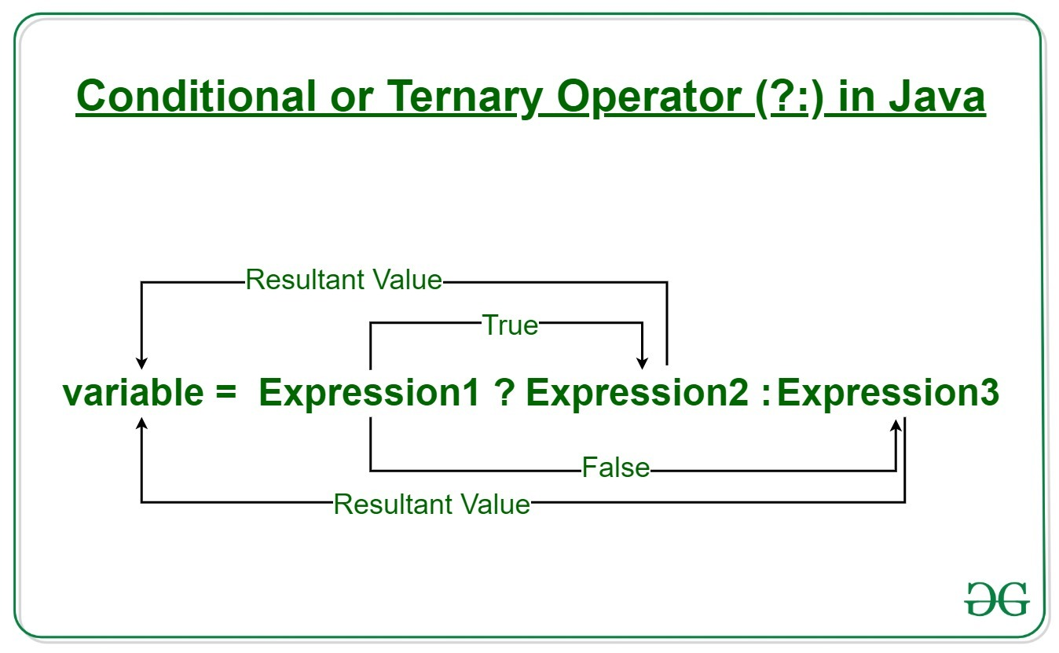
4. Ternary Operator
Java ternary operator is the only conditional operator that takes three operands.
it follows the same algorithm as of if-else statement, the conditional operator takes less space and helps to write the if-else statements in the shortest way possible.
Syntax :
variable = Expression1 ? Expression2: Expression3

Slide 38
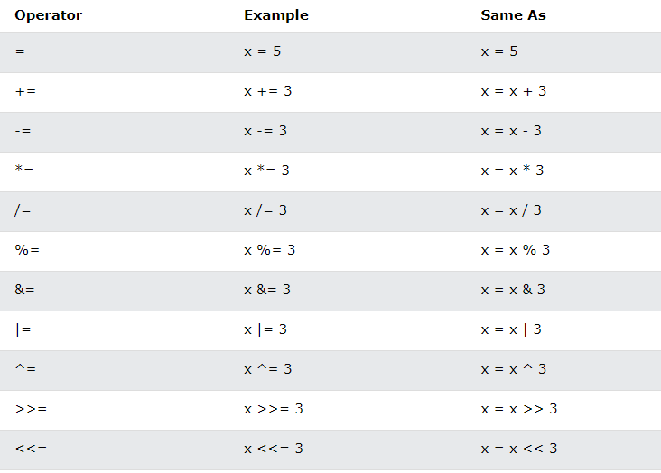
5. Assignment Operator
Assignment operators are used to assign values to variables.
Example :
int x=10;

Slide 39
6. Relational Operator
Relational Operators are a bunch of binary operators used to check for relations between two operands, including equality, greater than, less than, etc.
They return a Boolean result after the comparison and are extensively used in looping statements as well as conditional if-else statements and so on.
Syntax:
variable1 relation_operator variable2
comparison | < > <= >= instanceof
equality | == !=

Slide 40
CONTROL STATEMENTS
A Java Program normally executes from top to bottom but if we want to control the order of execution of program, based on the logic and values , We use Control Statements.
1)Selection or Conditional Statements or Decision making Statements
e.g.- if ,if-else ,if-else-if ,nested if and switch
2)Iteration or looping Statements
e.g. -for
-while
-do-while
3)Jump Statements
e.g. –break
-continue
-return
-goto

Slide 41
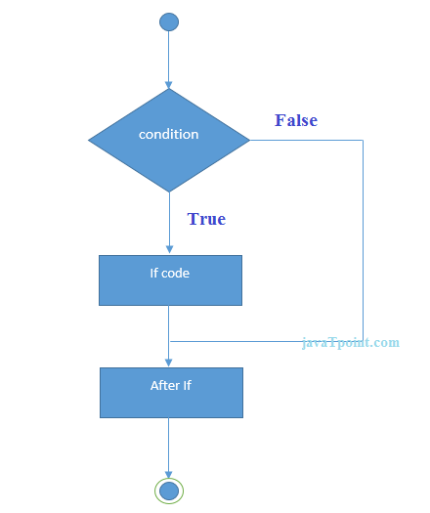
1.Decision-Making statements
decision-making statements decide which statement to execute and when.
Decision-making statements evaluate the Boolean expression and control the program flow depending upon the result of the condition provided.
Examples: if ,if-else,if-else-if ,nested-if and switch.
Syntax:
if(condition)
{
//body
}

Slide 42
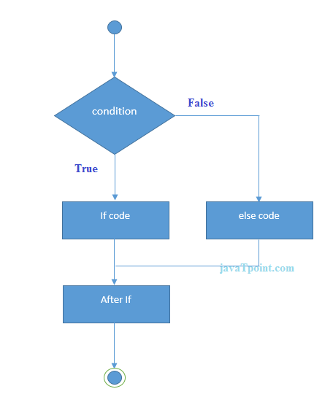
If-else
In if-else statements, if the specified condition in the if statements is true ,then if statements will execute otherwise else statement will be executed.
Syntax:
if(condition){
//body
}else{
//body
}

Slide 43
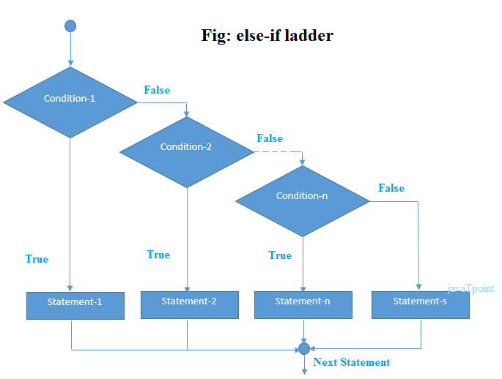
If-else-if
In if-else-if statements, if the condition is true ,the associated statement will be executed and the remaining condition will be bypassed. if none of the conditions are true then else block will execute.
Syntax:
if(condition1){
//body
}else if(condition2) {
//body
}else if(condition3) {
//body
} ...
else{
//body
}

Slide 44
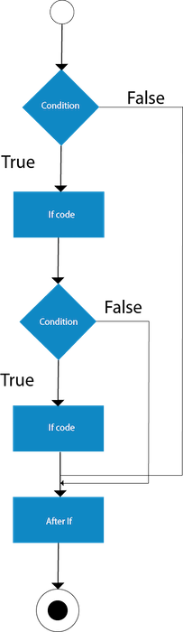
Nested if
The nested if statement represents the if block within another if block. Here, the inner if block condition executes only when outer if block condition is true.
Syntax:
if(condition){
//code to be executed
if(condition){
//code to be executed
}
}

Slide 45
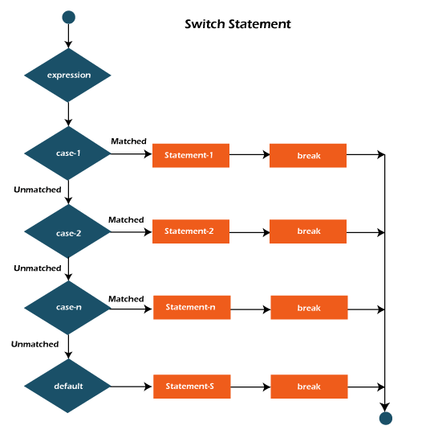
Switch Statement
The switch statement is multi-way branch statement. The Switch statement defines multiple paths of execution of a program.
It provides a better alternative than a large series of if-else-if
Syntax:
switch(variable to tested)
{
case value1:
//statement1
break;
case value2:
//statement2
break;
default :
//body
break;
}

Slide 46
Points to Remember
There can be one or N number of case values for a switch expression.
The case value must be of switch expression type only. The case value must be literal or constant. It doesn't allow variables.
The case values must be unique. In case of duplicate value, it renders compile-time error.
The Java switch expression must be of byte, short, int, long (with its Wrapper type), enums and string.
Each case statement can have a break statement which is optional. When control reaches to the break statement, it jumps the control after the switch expression. If a break statement is not found, it executes the next case.
The case value can have a default label which is optional.

Slide 47
Looping or Iteration statements
In Iteration or looping statements, the same code fragment executes several times until a specific condition satisfied.
Iteration statements executes the same set of instructions until a termination condition is met.
Flow Of Iteration Statement
Condition
If condition is “false”
If condition is “True”
Conditional code

Slide 48
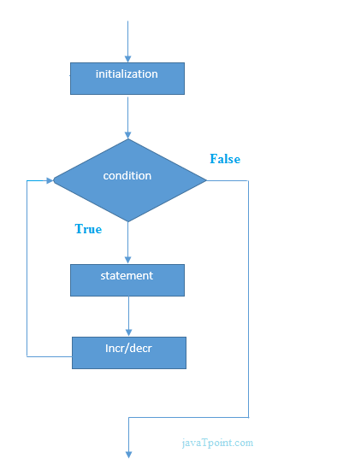
for loop
A for loop executes a statement(that is usually a block) as long as Boolean condition evaluates to true.
A for loop is a combination of the three elements initialization statements (or it can be any valid java statement) , Boolean expression and increment or decrement statement.
Syntax:
for(initialization; condition; inc/dec)
{
//Statements
}

Slide 49
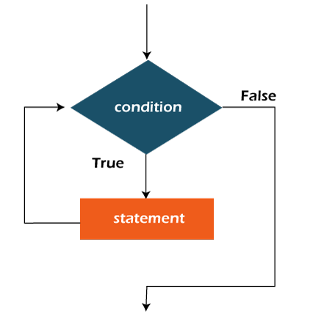
while loop
The Java while loop is used to iterate a part of the program repeatedly until the specified Boolean condition is true.
As soon as the Boolean condition becomes false, the loop automatically stops.
Syntax:
while (condition){
//Statement
Increment / decrement statement
}

Slide 50
do-while loop
The Java do-while loop is used to iterate a part of the program repeatedly, until the specified condition is true.
If you must have to execute the loop at least once, it is recommended to use a do-while loop.
Java do-while loop is called an exit control loop. Therefore, unlike while loop and for loop, the do-while check the condition at the end of loop body.
The Java do-while loop is executed at least once because condition is checked after loop body.

Slide 51
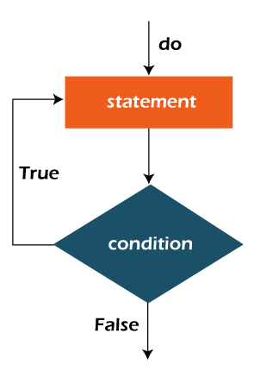
Syntax:
do{
//code to be executed / loop body
//update statement
}while (condition);

Slide 52
Array
An array is an object that holds a fixed number of values of homogeneous or similar data-type.
Or say An array is a Data Structure where we store similar elements.
The length of an array is assigned when the array is created and After creation, its length is fixed.
For Example : int a[]=new int[6];
It will create an array of length 6 and index value will always start from 0.
Elements In Array
10 | 20 | 30 | 40 | 50 | 60
0
1
2
3
4
5

Slide 53
Features of An Array
A java array variable can be declared like other variables with [] after the data type.
The variables in the array are ordered and each have an index beginning from 0.
In java, Arrays are objects, and thus they occupy memory in ‘Heap Area’.
The direct superclass of an array type is Object
They are always created at runtime.
The length of array can be find using member ‘length’.

Slide 54
Advantages of an Array
Arrays are used to store multiple data items of same type by using only single name.
We can access any element randomly by using indexes provided by arrays.
Arrays can be used to implement other data structure like linked lists ,Stacks ,queues ,trees ,graphs etc.
Primitive type to wrapper classes object conversion will not happen so it is so fast.

Slide 55
Disadvantage of an Array
Fixed Size : We need to mention the size of the array, thus they have fixed size. When array is created ,size cannot be changed.
Memory Wastage : There is a lot of chances of memory wastage. Suppose we create an array of length 100 but only 10 elements are inserted ,then 90 blocks are empty and thus memory wasted.
Strongly Typed : Arrays stores only similar data type, thus strongly typed.
Reduce Performance :The elements of array stored in consecutive memory location ,thus to delete an element in an array we need to traverse through out the array so this will reduce performance.
No Methods : Arrays does not have add or remove methods.

Slide 56
Types of Array in Java
Single-Dimensional Array(1 D array)
Multi-Dimensional Array
Two-Dimensional Array
Three-Dimensional Array

Slide 57
Single Dimensional array
Declaration Of An Array :
Different ways of Declaration of Arrays are :
int []a;
int[] a;
int[]a;
int a[];
Most Preferred array Declaration is ‘int[] a;’ ,because here ‘a’ is one dimensional int array ,thus name is clearly separated with type.
We cannot provide size at the time of array declaration i.e. ‘int[3]a;’ or ‘int a[3]’ statement is incorrect.
Note that there is difference between below two statements:
int[] a ,b; //here ‘a’ and ‘b’ both are arrays.
int a[],b;//here ‘a’ is array and b is simple int type variable, not an array.

Slide 58
Creation of An Array :
We can create an array after declaration as follows:
int[] a;//array Declaration
a=new int[3];//array creation;
It is compulsory to declare the size of an array at the time of creation;
We can declare and create array within a single line as follows:
int[] a=new int[3];
If we declare size of array as ‘0’ i.e. ‘int[] a=new [0];’ then program will successfully compile and execute.
If we declare size of array as negative i.e. ‘int[] a=new int[-3];’ ,then the program will successfully compile but when we run the program ,it will throw ‘NegativeArraySizeException’ exception.

Slide 59
Initialization of an Array:
We can create an array after declaration as follows: int[] a=new int[3]; //array declaration and creation
a[0]=10; //array initialization at 0 index position
a[1]=20;
a[2]=30;
If we initialize at array position 3 or more i.e. ‘a[3]=40;’,it will throw ‘ArrayIndexOutOfBoundException’ exception ,so we cannot initialize an array more than its size.
We can declare ,create and initialize array within a single line as follows:
int[] a={10,20,30};
int[] a=new int[]{10,20,30};
10 | 20 | 30
0
1
2

Slide 60
Retrieve Elements from An Array:
An array given i.e. ‘int[] a={10,20,30};’,now we can print elements of an array by two ways ,which are as follows:
Way1 : (Using for loop)
for(int i=0;i<a.length;i++)
{
System.out.println(a[i]);
}
Way 2: (Using for-each loop)
for(int i:a)
{
System.out.println(i);
}

Slide 61
Multi-Dimensional Array (2D)
An Array having multiple rows or column is known as multi-dimensional Array.
These are also known as array of arrays because array is present in another array.
There Are two Types of Multi-Dimensional Arrays
2-D Array
3-D Array
We can Represent 2-D multi-dimensional array as follows:
Index
Position
Array Pointing another Array
Elements in
Array
Columns
Index
Position
0
1
2
0,0
0,1
0,2
0
1
10 | 20 | 30
10 | 20 | 30
40 | 50 | 60
Rows
1,0
1,1
1,2
0
1
3
Elements in
Array
10 | 20 | 30

Slide 62
Two Dimensional array
Declaration Of An 2-D Array :
Different ways of Declaration of Arrays are :
int [][]a;
int[][] a;
int[][]a;
int a[][];
int[] a[];
Most Preferred array Declaration is ‘int[][] a;’ ,because here ‘a’ is two dimensional int array ,thus name is clearly separated with type.
We cannot provide size at the time of array declaration i.e. ‘int[3][5] a;’ or ‘int a[2][3]’ statement is incorrect.
Note that there is difference between below two statements:
int[][] a ,b; //here ‘a’ and ‘b’ both are 2-D arrays.
int[] a[],b;//here ‘a’ is 2-D array and b is 1-D array, not an array.

Slide 63
Creation of 2-D Array :
We can create an array after declaration as follows:
int[] a;//array Declaration
a=new int[3][2];//array creation;
int[] a;//array Declaration
a=new int[2][0];//array creation;
a[0]=new int[4];
a[1]=new int[3];
Matrix Array Creation
Jagged Array Creation

Slide 64
It is compulsory to declare the size of an array at the time of creation;
We can declare and create array within a single line as follows:
int[][] a=new int[2][3];------------→ Matrix Array
int[][] a=new int[2][];
a[0]=new int[4]; --------→Jagged Array
a[1]=new int[2];
If we declare size of array as ‘0’ i.e. ‘int[] a=new [0];’ then program will successfully compile and execute.
If we declare size of array as negative i.e. ‘int[] a=new int[-3];’ ,then the program will successfully compile but when we run the program ,it will throw ‘NegativeArraySizeException’ exception.

Slide 65
OOP’s
It is stand for Object Oriented Programming System/Structure.
OOP is a Programming Paradigm/Methodology.
Object Oriented Paradigm
Procedural Paradigm
Functional Paradigm
Logical Paradigm
Structural Paradigm
6 main pillars of Oops are :-
Class
Objects & Methods
Inheritance
Abstraction
Polymorphism
Encapsulation

Slide 66
Class
Class Is the collection of Object.
Class is not a real World Entity. It is just a template or blueprint or prototype.
Class does not occupy the memory.
Syntax:
access_modifier class ClassName
{
-Methods
-Constructors
-fields
-blocks
-Nested Class
}
Eat
Animal
Dog
Run
Cat
Eat
Birds
Sparrow
Fly
Pigeon
start
Vehicle
Thar
stop
Innova

Slide 67
Object
Object is an Instance of class .
Object is a Real World Entity.
Object occupies Memory.
Object consist of :-
Identity :- name
State/Attribute:-color ,breed ,age
Behaviors :- eat ,run ,bark
How to Create an Object
new Keyword
Clone() method
newInstance()method
Deserialization
Factory Method

Slide 68
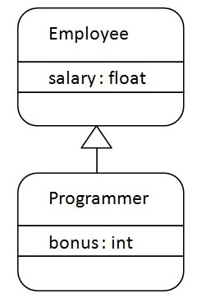
Inheritance
Inheritance is inheriting the properties of parent class into the child class.
Inheritance in java is a mechanism in which one object acquires all the properties and behavior of a parent object.
Advantage :
Code Reusability.
It promotes runtime polymorphism by allowing method overriding.
Disadvantages:
Using Inheritance the two classes (Parent and Child class ) gets tightly coupled.

Slide 69
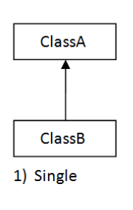
Types of Inheritance
Single Inheritance
In single Inheritance one class Extends another class (one class only).
Parent/Super/Base class
Child/Sub class/Derived Class

Slide 70
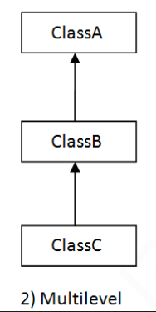
Multilevel Inheritance :
In multilevel Inheritance, one class can inherit from a derived class. Hence the derived class becomes the base class for new class.

Slide 71
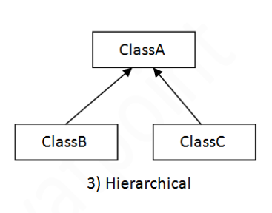
Hierarchical Inheritance :
In Hierarchical Inheritance, one class can inherited by may subclasses.

Slide 72
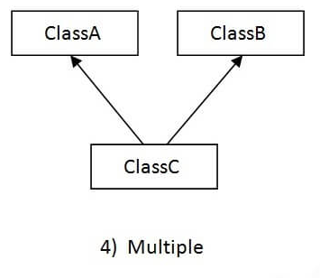
Multiple Inheritance :
In Multiple Inheritance, one class extending more than one class.
Java Does not support Multiple inheritance.

Slide 73
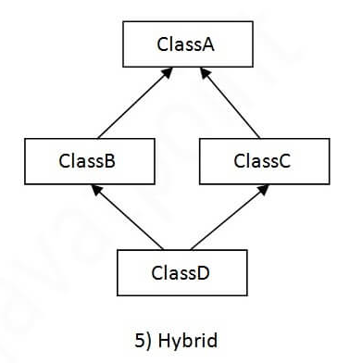
Hybrid Inheritance :
Hybrid Inheritance is a combination of any two Inheritances.
Java does not support hybrid Inheritance.

Slide 74
Super Keyword
The super keyword in Java is a reference variable which is used to refer immediate parent class object.
Usage Of Super Keyword :
super can be used to refer immediate parent class instance variable.
super can be used to invoke immediate parent class method.
super() can be used to invoke immediate parent class constructor.

Slide 75
Polymorphism
Polymorphism is derived from 2 Greek words: poly and morphs. The word "poly" means many and "morphs" means forms. So polymorphism means many forms.
Polymorphism in Java is a concept by which we can perform a single action in different ways.
Example:
A person at the same time can have different characteristics. Like a man at the same time is a father, a husband, an employee. So the same person possesses different behavior in different situations.
There are two types of polymorphism in Java:
compile-time polymorphism
runtime polymorphism

Slide 76
Compile Time Polymorphism
This type of polymorphism is achieved by method overloading.
METHOD OVERLOADING:
When there are multiple functions with the same name but different parameters then these functions are said to be overloaded.
Functions can be overloaded by change in the number of arguments or/and a change in the type of arguments.

Slide 77
Runtime Polymorphism
It is also known as Dynamic Method Dispatch.
This type of polymorphism is achieved by Method Overriding.
METHOD OVERRIDING:
When there are multiple functions with the same name ,same parameter but different class then these functions are said to be overridden.
In this process, an overridden method is called through the reference variable of a superclass.

Slide 78
Final Keyword
The final keyword in java is used to restrict the user.
The java final keyword can be used in many context. Final can be:
variable
method
class
If you make any variable as final, you cannot change the value of final variable(It will be constant).
If you make any method as final, you cannot override it.
If you make any class as final, you cannot extend it.

Slide 79
Abstraction
Abstraction is Hiding implementation and just Highlighting the setup services that we are offering.
We can achieve Abstraction in two ways:
Abstract class (0-100%)
Interfaces (100%)

Slide 80
Abstract class & Abstract Method
A class which is declared as abstract is known as an abstract class.
It can have abstract and non-abstract methods.
It needs to be extended and its method implemented.
It cannot be instantiated.
It can have constructors and static methods also.
It can have final methods which will force the subclass not to change the body of the method.
Syntax:
abstract class class_name{
//Statements
}

Slide 81
Interface
Interface are similar to Abstract Class but having all the methods of abstract type.
Interfaces are the Blueprint of the class. It specify what a class must do and not how.
We can not create an instance of Interface.
Use Of Interface:
It is Used to Achieve Abstraction.
It supports multiple Inheritance.
It can be Used to Achieve Loose coupling.

Slide 82
Syntax:
Interface Interface_name{
//Method (public abstract)
//Fields (public static final)
}
Modifications:
1)8th version
default concrete Method
Static concrete method(Public)
2)9th Version
Private Methods

Slide 83

Encapsulation
Encapsulation in java is a mechanism of wrapping the data (Variables) and code acting on the data (methods) together as a single unit.
It is a way to achieve data hiding in Java because other class will not be able to access the data through the private data members.
It provides you the control over the data.
Steps To achieve the Encapsulation :
Declare the variable of a class as private.
Provide public setter and getter methods to modify and view the variables values.

Slide 84
What is Exception ?
An exception is an unwanted or unexpected event, which occur during the execution of a program i.e. run time, that disrupts the normal flow of Program.
What Is Exception Handing ?
The Exception Handling in Java is one of the powerful mechanism to handle the runtime errors so that the normal flow of the application can be maintained.

Slide 85
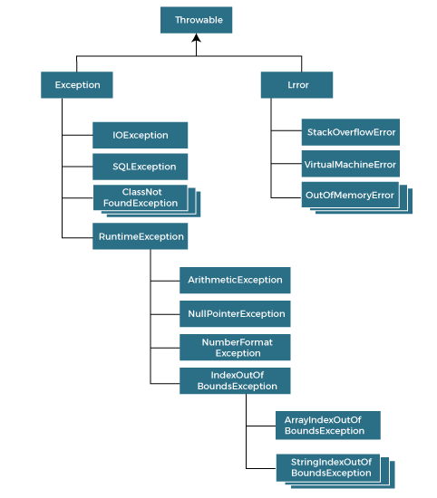
Hierarchy of Java Exception classes

Slide 86
Difference between Exception & Error
Exception | Error
1.Exception occurs because of our program. | 1.Error occurs because of lack of System resources.
2.Exception are Recoverable i.e. programmer can handle them using try-catch block. | 2.Errors are not recoverable i.e. programmers can handle them to their level
3.Exceptions are two types : Compile time or Checked Exception. Runtime or Unchecked Exception. | 3.Errors are only one type: Runtime Exceptions or Unchecked Exceptions

Slide 87
Exception Handling
Whenever there is an exception, the method in which exception occur will create an object and that object will store three things :
1.Exception name 2.Description 3.stack trace
JVM
NO
YES
Default
Exception
Handler
Manually
Handle
-try
-catch
-finally
-throw
-throws
Print

Slide 88
Multi Tasking
Performing multiple tasks at single time.
Increases the performance of CPU.
Types:
Process based Multitasking (MP)
Thread Based Multitasking(MT)
VLC
Word
Browser
Operating System
CPU

Slide 89
Multi Processing
When one System is connected to the Multiple Processor in order to complete the task.
It is Best Suitable at system level or os level.
VLC
Word
Browser
Operating System
CPU
CPU
CPU

Slide 90
Multithreading
Executing multiple threads (sub-process, small Tasks) at single Time.
VLC
Video music PB Timing
Operating System
Operating System
Software ,Games ,Animations.
Multithreading is best suitable at programming level.

Slide 91
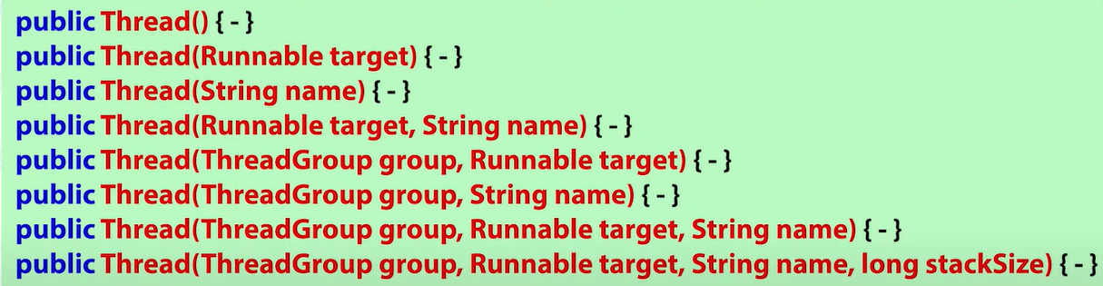
Ways To Create Thread
Thread (Class)
Runnable (Interface)
Thread Class Constructors
public class Thread Implements Runnable {
}

Slide 92
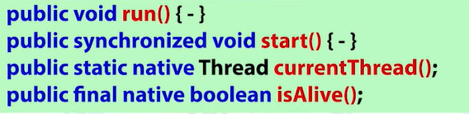


Thread Class Methods
public class Thread Implements Runnable {
}
BASIC METHODS
NAMING METHODS
DAEMON THREAD METHODS
PRIORITY BASED METHODS

Slide 93
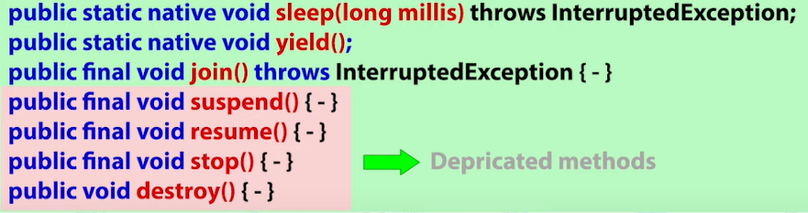
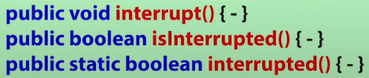
Thread Class Methods
public class Thread Implements Runnable {
}
PREVENT THREAD EXECUTION
INTERRUPTING A THREAD METHODS

Slide 94
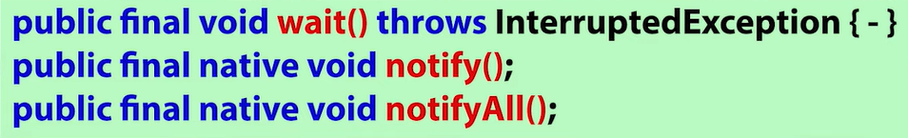
Inter-Thread Communications
public class Object {
}
Inter-Thread
Communications
Methods

Slide 95
Lifecyle of Thread
[ 3 ]
JVM will Allocate the processor
When Task Is completed
Create
Born
New Thread
Runnable
Running
Dead
[ 4 ]
Sleep(),waiting(),suspend() etc.
Non Runnable state

Slide 96
Create Thread By Thread Class
Step 1:Extends “Thread” Class
Step 2: Override the “run()” Method.
Step 3:Create an Object Of the class.
Step 4: Start The Thread Using start() method.

Slide 97
Create Thread By Runnable Interface
Step 1:Implements “Runnable” Interface
Step 2: Override the “run()” Method.
Step 3:Create an Object Of the class.
Step 4: Create an Object Of the Thread class and pass the parameter in constructor of Thread class.
Step 5: Start the Thread.

Slide 98
Different Cases Of Executing Threads
Performing Single Task From Single Thread.
Performing Single Task From Multiple Thread.
Performing Multiple Task From Single Thread.
Performing Multiple Task From Multiple Thread.

Slide 99
Naming Thread
The Thread class provides methods to change and get the name of a thread.
Syntax:
public String getName(): is used to return the name of a thread.
public void setName(String name): is used to change the name of a thread.
One can also set the name of a thread at the time of the creation of a thread, without using the setName() method.

Slide 100
Daemon Thread
Daemon thread in Java is a service provider thread that provides services to the user thread.
Its life depend on the user threads i.e. when all the user threads dies, JVM terminates this thread automatically.
There are many java daemon threads running automatically e.g. gc, finalizer etc.
It is a low priority thread.
Syntax:
public void setDaemon(boolean status)
public boolean isDaemon()

Slide 101
Cases to create Daemon Thread
We have to create Daemon Thread Before Starting the Thread.
if we create daemon thread after starting it, it will throw run-time Exception. i.e. IllegalThreadStateException.
We cannot create main thread as Daemon Thread.

Slide 102
Thread Priorities
JVM provides priorities to each Thread & according to these priorities ,JVM allocates the processor.
Priorities Is Represented in the form of Integer value. From 1-10.
1→MIN_PRIORITY
5→NORM_PRIORITY
10→MAX_PRIORITY
10
9
8
7
6

Slide 103
Below Are not the priorities :
0, <1, >10.
MINIMUM_PRIORITY
LOW_PRIORITY
MIDIUM_PRIORITY
NORMAL_PRIORITY
MAXIMUM_PRIORITY
HIGH_PRIORITY
Methods In Thread
setPriority()
getPriority()
Nature Default :- Priorities is Inherited from Parent Thread.
By Default main thread priority is 5.
If priority is not between 1-10,then it will throw runtime exception i.e. IlleagalArgumentException.
Priorities Depends On The Platform.(Windows does not support to the Priorities).

Slide 104
Thread.sleep()
The method sleep() is being used to halt the working of a thread for a given amount of time.
The time up to which the thread remains in the sleeping state is known as the sleeping time of the thread.
Syntax:
public static native void sleep(long mls) throws InterruptedException
public static void sleep(long mls, int n) throws InterruptedException
The method sleep() with the one parameter is the native method, and the implementation of the native method is accomplished in another programming language.
The other methods having the two parameters are not the native method. That is, its implementation is accomplished in Java.
We can access the sleep() methods with the help of the Thread class.

Slide 105
Sleep() method important Points
If the value of milliseconds is negative then “illegalArgumentException” is thrown.
If the value of nanoseconds is not in the range from 0-999999 then “InterruptedException” is thrown
Whenever we want to use the sleep() method we also need to handle the “InterruptedException”.If we will not handle it, the JVM will show compilation error.
When any thread is sleeping and if any other thread interrupts it, then it throws “InterruptedException”.
When we use sleep method to pause the execution of thread. The thread schedular assign CPU to another thread if any thread exists. So, there is no guarantee that the thread wakes up exactly after the time specified in sleep method. It totally depends on the thread scheduler.
While the thread is sleeping, it doesn’t lose any locks or monitors that it acquires before sleeping.

Slide 106
Yield()
Which stops the current executing thread & give chance to other threads for execution.
Example:
Working: Java 5 :- internally its used sleep().
Java 6:-Thread provides hint to thread-scheduler ,then it depends
on Thread Scheduler to accept or ignore the hint.
Method :-public static native void yield();
Output may vary (different).
P1
P2
Billing counter
|||||||||||||||
|

Slide 107
join()
When the join() method is invoked, the current thread stops its execution and the thread goes into the wait state. The current thread remains in the wait state until the thread on which the join() method is invoked has achieved its dead state.
If interruption of the thread occurs, then it throws the InterruptedException.
Methods:
public final void join() throws InterruptedException
public final synchronized void join(long mls) throws InterruptedException
public final synchronized void join(long mls, int nanos) throws InterruptedException

Slide 108
Interrupt Method
Use:- It is used to interrupt an executing Thread.
interrupt() method will only works when the Thread is in sleeping or waiting state (sleep(),wait()).
If a thread is not in sleeping or waiting state then calling an interrupt() method will perform normal behavior.
When we use interrupt() method it throws an exception InterruptedException.
Syntax: public void interrupt()
{
…
}

Slide 109
interrupted() and isInterrupted()
-Interrupted() method is used to check whether a thread is interrupted or not.
-isInterrupted() method is used to check whether a thread a thread is interrupted or not
-interrupted() method clears the interrupted status from true to false if the thread is interrupted.
-isInterrupted method does not clear the interrupted status.
-interrupted() method will change the result if called twice.
-isInterrupted method will produce same result if called twice.
Syntax:
public static boolean interrupted(){--}
public boolean isInterrupted(){--}

Slide 110
Synchronization
What is Synchronization?
It is the process by which we control the accessibility of multiple thread to a particular shared resource.
Problem which can occur without Synchronization :-
Data Inconsistency
Thread interference
Advantage of Synchronization :-
No data Inconsistency Problem
No thread interference
Disadvantage of Synchronization :-
Increase the waiting time period of threads
Create Performance problems

Slide 111
How to achieve Synchronization
Types Of Synchronization
2 types Of Synchronization
Process Synchronization
Thread Synchronization
(Not Present in java multithreading)
2 types Of Thread Synchronization
Mutual Exclusive
Cooperation
(Inter-thread communication in java)
Can be achieved by 3 Ways :
1.By “Synchronized Method”
2.By “Synchronized Block”
3.By “Static Synchronized”
Can be achieved following Methods Of Object Class:-
1.wait()
2.notify()
3.notifyAll()

Slide 112
Inter Thread communication
Inter-Thread Communication is a mechanism in which a thread releases the lock and enter into paused state and another thread acquires the lock and continue to executed.
1.Wait():If any Thread calls the wait() method, it causes the current thread to releases the lock and wait until another thread invokes the notify() or notifyAll() method for this object, or specified amount of time has elapsed.
Syntax: public final void wait() throws InterruptedException(waits until object is notified)
public final void wait(long timeout) throws InterruptedEcpetion(waits for the specific amount of time)
2.notify() : this method is used to wake up a single thread and releases the object lock.
Syntax : public final void notify()
3.notifyAll() : This method is used to wake up all threads that are in waiting state.
Syntax: public final void notifyAll()
NOTE: To call wait(), notify() or notifyAll() method on any object, thread should own the lock of that object i.e. the thread should be inside synchronized area.

Slide 113
Difference between Array and collections
Array | Collections Framework
Array can store Primitive & non-primitive type of data. | Collection framework can store only non-primitive type of data.
Array can store only homogeneous type of data. | Collection Framework can store heterogeneous type of data.
Array Size is Fixed , we cannot increase or decrease the size of array at runtime. | collection Size is Dynamic, we can increase or decrease the size of array at runtime.
Arrays are inbuilt feature of java & thus we have to Develop the algorithm | Collection Framework is an API which provides predefined class ,interface & Methods

Slide 114
Collections in java
The Collection in Java is a framework that provides an architecture to store and manipulate the group of objects.
Java Collection means a single unit of objects. i.e., a group.
Java Collection framework provides many interfaces (Set, List, Queue, Deque) and classes (ArrayList, Vector, LinkedList, PriorityQueue, HashSet, LinkedHashSet, TreeSet).
What is a framework in Java
It provides readymade architecture.
It represents a set of classes and interfaces.
It is optional.
What is Collection framework
The Collection framework represents a unified architecture for storing and manipulating a group of objects. It has:
Interfaces and its implementations, i.e., classes
Algorithm

Slide 115
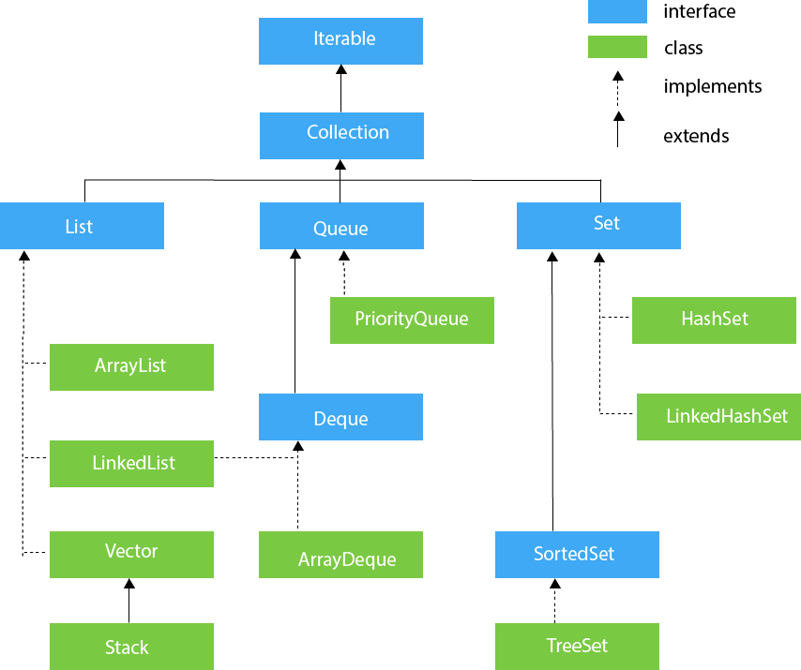
Hierarchy of Collection Framework The java.util package contains all the classes and interfaces for the Collection framework.

Slide 116
Difference between List And Set
List | Set
List is an index based Data Structure | Set is not index based data structure. It stores the data according to the hashcode values.
List can store duplicate elements. | Set does not allow to store Duplicate elements.
List can store any number of null values. | Set can store only one null value.
List follows the insertion order. | Set does not follows the insertion order.
We can iterate(get) the list elements by Iterator & ListIterator. | We can iterate the set Elements by Iterator.

Slide 117
Methods Of Collection Interface
No. | Method | Description
1 | public boolean add(E e) | It is used to insert an element in this collection.
2 | public boolean addAll(Collection<? extends E> c) | It is used to insert the specified collection elements in the invoking collection.
3 | public boolean remove(Object element) | It is used to delete an element from the collection.
4 | public boolean removeAll(Collection<?> c) | It is used to delete all the elements of the specified collection from the invoking collection.
5 | default boolean removeIf(Predicate<? super E> filter) | It is used to delete all the elements of the collection that satisfy the specified predicate.
6 | public boolean retainAll(Collection<?> c) | It is used to delete all the elements of invoking collection except the specified collection.
7 | public int size() | It returns the total number of elements in the collection.
8 | public void clear() | It removes the total number of elements from the collection.
9 | public boolean contains(Object element) | It is used to search an element.
10 | public boolean containsAll(Collection<?> c) | It is used to search the specified collection in the collection.
11 | public Iterator iterator() | It returns an iterator.
12 | public Object[] toArray() | It converts collection into array.
13 | public <T> T[] toArray(T[] a) | It converts collection into array. Here, the runtime type of the returned array is that of the specified array.
14 | public boolean isEmpty() | It checks if collection is empty.
15 | default Stream<E> parallelStream() | It returns a possibly parallel Stream with the collection as its source.
16 | default Stream<E> stream() | It returns a sequential Stream with the collection as its source.
17 | default Spliterator<E> spliterator() | It generates a Spliterator over the specified elements in the collection.
18 | public boolean equals(Object element) | It matches two collections.
19 | public int hashCode() | It returns the hash code number of the collection.

Slide 118
ArrayList
Arraylist is Implemented class of List Interface which is present in java.util package.
Syntax:
class ArrayList implements List{
//constructors and Methods
}
ArrayList is created on the basis of growable or Resizable array.
arr
al
0
1
2
3
4
5

Slide 119
Properties of ArrayList
ArrayList Are Indexed Based data Structure.
ArrayList Can store Different data Types or heterogeneous type of data.
ArrayList can store Duplicate values.
Arraylist can store any number of null Values.
Arraylist Follows insertion order.
Arraylist does not follow the sorting order.
ArrayList are non-Synchronized.

Slide 120
LinkedList
LinkedList is an Implemented class of List Interface which is present in java.util package.
Syntax:
class LinkedList implements List,Deque
{
//Constructors
//Methods
}
The Underlined data Structure of LinkedList is “Doubly Linked List” or “Circular Linked List”.

Slide 121
Advantage of Linked List:
Insertion and deletion operation are efficient and fast.
We can traverse the list in Forward and Backward direction both.
Disadvantage of Linked List:
It occupy extra space for previous node address.
In case of Insertion or Deletion of element in between we have to manage previous and next node.

Slide 122
Properties of LinkedList
LinkedList Are Indexed Based data Structure.
LinkedList Can store Different data Types or heterogeneous type of data.
LinkedList can store Duplicate values.
LinkedList can store Multiple number of null Values.
LinkedList Follows insertion order.
LinkedList does not follows the sorting order.
LinkedList are non-Synchronized.

Slide 123
Difference between ArrayList and LinkedList
ArrayList | LinkedList
Arraylist acts as List | LinkedList act as List and deque
The underline data structure of arraylist is Growable or resizable array. | The underline data structure of Linkedlist is Doubly Linked List or Circular Linked List.
Elements are stored in contiguous memory location. | Elements are not stored in contiguous memory location.
Arraylist are good for Retrieval operations. | Linkedlist are good for insertion or deletion operation.
ArrayList are worst for insertion or deletion operation. | Linkedlist are worst for retrieval operations.

Slide 124
JDK 1.0
In this version java provides classes and interfaces in which we can store the data/objects.
for ex. Vector ,Stack ,Hashtable ,properties ,Dictionary.
JDK 1.2 version
Collection Framework was introduced .
All Legacy classes are Synchronized.

Slide 125
Vector
Vector is legacy class which was introduced in JDK 1.0.
Vector is an implemented class of list interface which is present in java.util package.
Syntax:
class Vector implements List{
//Constructors
//Methods
}
The underline data structure of Vector is “Growable Array or resizable array”

Slide 126
Methods In Vectors:
It Contain List & collections interface methods.
addElement(Object obj)
Firstelement()
lastElement()
removeElement(Object obj)
removeElementAt(int index)
removeAllElements()
Capacity()

Slide 127
Properties of Vector
Vector Are Indexed Based data Structure.
Vector Can store Different data Types or heterogeneous type of data.
Vector can store Duplicate elements.
Vector can store Multiple of null Values.
Vector Follows insertion order.
Vector does not follow the sorting order.
Vector are Synchronized Collection.

Slide 128
Stack
Stack is legacy class which was introduced in JDK 1.0.
Stack is an Child class of Vector class ,which is present in java.util package.
Syntax:
class Stack extends Vector{
//Constructors
//Methods
}
The underline data structure of Vector is “Growable Array or resizable array”

Slide 129
Properties of Stack
Stack class was designed on the basis of LIFO Last In First Out.
Stack can be implemented on the basis of array ,arrayList ,LinkedList or Vector.
Stack is Indexed Base Data Structure.
Construtor:
Stack()
Methods:
pop()
peak()
push()
Search(Object o)
empty()

Slide 130
Set Interface
The set interface is present in java.util package and extends the Collection interface.
It is an unordered collection of objects in which duplicate values cannot be stored.
We can store at most one null value in Set.
Set is implemented by HashSet, LinkedHashSet, and TreeSet.

Slide 131
Hashset
HashSet class implements Set Interface.
It represents the collection that uses a hash table for storage.
The objects are inserted based on their hashcode.
Hashing is used to store the elements in the HashSet.
It contains unique items.

Slide 132
LinkedHashSet
LinkedHashSet class represents the LinkedList implementation of Set Interface.
It extends the HashSet class and implements Set interface.
Like HashSet, It also contains unique elements.
It maintains the insertion order and permits null elements.

Slide 133
SortedSet Interface
SortedSet is the alternate of Set interface that provides a total ordering on its elements.
The elements of the SortedSet are arranged in the increasing (ascending) order.
The SortedSet provides the additional methods that inhibit the natural ordering of the elements.

Slide 134
Treeset
TreeSet uses a tree data structure for storage.
Like HashSet, TreeSet also contains unique elements.
However, the access and retrieval time of TreeSet is quite fast.
The elements in TreeSet stored in ascending order.
But we can iterate in descending order using the method “TreeSet.descendingIterator()”.

Slide 135
Generics in Java
The Java Generics programming is introduced in J2SE 5 to deal with type-safe objects. It makes the code stable by detecting the bugs at compile time.
Before generics, we can store any type of objects in the collection, i.e., non-generic. Now generics force the java programmer to store a specific type of objects.
Advantage of Java Generics
Type-safety: We can hold only a single type of objects in generics. It doesn?t allow to store other objects.
Type casting is not required: There is no need to typecast the object.
Compile-Time Checking: It is checked at compile time so problem will not occur at runtime. The good programming strategy says it is far better to handle the problem at compile time than runtime.

Slide 136
Java Map Interface
Map Is an interface which is present in “java.util” package.
Map does not inherit collection interface.
Map was introduced in JDK 1.2 version.
A map contains values on the basis of key, i.e. key and value pair.
Each key and value pair is known as an entry.
A Map is useful if you have to search, update or delete elements on the basis of a key.
Syntax:
package java.util;
public interface Map
{
//Methods
}

Slide 137
Properties Of Map
Map Stores the data in key-value pair.
In Map, Key should be unique but value can be duplicate.
In Map, we can store maximum one null value in key but in values we can store any number of Values.
Map does not follow the sorting & inserting order.
Key | Value
101 | Sai
102 | Ramesh
103 | Ajay
104 | Ganesh

Slide 138
Java Map Hierarchy
There are two interfaces for implementing Map in java: Map and SortedMap, and three classes: HashMap, LinkedHashMap, and TreeMap.
A Map doesn't allow duplicate keys, but you can have duplicate values.
HashMap and LinkedHashMap allow null keys and values, but TreeMap doesn't allow any null key or value.

Slide 139
A Map can't be traversed, so you need to convert it into Set using keySet() or entrySet() method.
Class | Description
HashMap | HashMap is the implementation of Map, but it doesn't maintain any order.
LinkedHashMap | LinkedHashMap is the implementation of Map. It inherits HashMap class. It maintains insertion order.
TreeMap | TreeMap is the implementation of Map and SortedMap. It maintains ascending order.

Slide 140
Useful methods of Map interface
Method | Description
V put(Object key, Object value) | It is used to insert an entry in the map.
void putAll(Map map) | It is used to insert the specified map in the map.
V putIfAbsent(K key, V value) | It inserts the specified value with the specified key in the map only if it is not already specified.
V remove(Object key) | It is used to delete an entry for the specified key.
boolean remove(Object key, Object value) | It removes the specified values with the associated specified keys from the map.
Set keySet() | It returns the Set view containing all the keys.
Set<Map.Entry<K,V>> entrySet() | It returns the Set view containing all the keys and values.
void clear() | It is used to reset the map.
V compute(K key, BiFunction<? super K,? super V,? extends V> remappingFunction) | It is used to compute a mapping for the specified key and its current mapped value (or null if there is no current mapping).
V computeIfAbsent(K key, Function<? super K,? extends V> mappingFunction) | It is used to compute its value using the given mapping function, if the specified key is not already associated with a value (or is mapped to null), and enters it into this map unless null.
V computeIfPresent(K key, BiFunction<? super K,? super V,? extends V> remappingFunction) | It is used to compute a new mapping given the key and its current mapped value if the value for the specified key is present and non-null.
boolean containsValue(Object value) | This method returns true if some value equal to the value exists within the map, else return false.
boolean containsKey(Object key) | This method returns true if some key equal to the key exists within the map, else return false.
boolean equals(Object o) | It is used to compare the specified Object with the Map.

Slide 141
Useful methods of Map interface
void forEach(BiConsumer<? super K,? super V> action) | It performs the given action for each entry in the map until all entries have been processed or the action throws an exception.
V get(Object key) | This method returns the object that contains the value associated with the key.
V getOrDefault(Object key, V defaultValue) | It returns the value to which the specified key is mapped, or defaultValue if the map contains no mapping for the key.
int hashCode() | It returns the hash code value for the Map
boolean isEmpty() | This method returns true if the map is empty; returns false if it contains at least one key.
V merge(K key, V value, BiFunction<? super V,? super V,? extends V> remappingFunction) | If the specified key is not already associated with a value or is associated with null, associates it with the given non-null value.
V replace(K key, V value) | It replaces the specified value for a specified key.
boolean replace(K key, V oldValue, V newValue) | It replaces the old value with the new value for a specified key.
void replaceAll(BiFunction<? super K,? super V,? extends V> function) | It replaces each entry's value with the result of invoking the given function on that entry until all entries have been processed or the function throws an exception.
Collection values() | It returns a collection view of the values contained in the map.
int size() | This method returns the number of entries in the map.

Slide 142
Methods of Map.Entry interface
Method | Description
K getKey() | It is used to obtain a key.
V getValue() | It is used to obtain value.
int hashCode() | It is used to obtain hashCode.
V setValue(V value) | It is used to replace the value corresponding to this entry with the specified value.
boolean equals(Object o) | It is used to compare the specified object with the other existing objects.
static <K extends Comparable<? super K>,V> Comparator<Map.Entry<K,V>> comparingByKey() | It returns a comparator that compare the objects in natural order on key.
static <K,V> Comparator<Map.Entry<K,V>> comparingByKey(Comparator<? super K> cmp) | It returns a comparator that compare the objects by key using the given Comparator.
static <K,V extends Comparable<? super V>> Comparator<Map.Entry<K,V>> comparingByValue() | It returns a comparator that compare the objects in natural order on value.
static <K,V> Comparator<Map.Entry<K,V>> comparingByValue(Comparator<? super V> cmp) | It returns a comparator that compare the objects by value using the given Comparator.

Slide 143
Hashmap
Hashmap is implemented class of map Interface which id present in java.util package.
Syntax :
package java.util;
class Hashmap implements Map {
//Constructors and Methods
}
Hashmap underline data-structure is “Hashtable”.

Slide 144
Properties Of Hashmap
Hashmap stores the value in key-value pair.
Each key value pair is known as Entry.
In Hashmap key should be always Unique but values can be duplicate.
Hashmap contains max one null value in key but it can store multiple null values inn value.
Hashmap can store heterogeneous elements.
Hashmap does not follow the sorting and insertion order.
Hashmap is non synchronized data Structure.

Slide 145
LinkedHashMap class
Java LinkedHashMap class is Hashtable and Linked list implementation of the Map interface, with predictable iteration order.
It inherits HashMap class and implements the Map interface.
Points to remember
Java LinkedHashMap contains values based on the key.
Java LinkedHashMap contains unique elements.
Java LinkedHashMap may have one null key and multiple null values.
Java LinkedHashMap is non synchronized.
Java LinkedHashMap maintains insertion order.

Slide 146
TreeMap
TreeMap is the implementation of Map and SortedMap
It provides an efficient means of storing key-value pairs in sorted order.
Points to remember
Java TreeMap contains values based on the key. It implements the NavigableMap interface and extends AbstractMap class.
Java TreeMap contains only unique elements.
Java TreeMap cannot have a null key but can have multiple null values.
Java TreeMap is non synchronized.
Java TreeMap maintains ascending order.

Slide 147
Clonning
The object cloning is a way to create exact copy of an object.
The clone() method of Object class is used to clone an object.
The java.lang.Cloneable interface must be implemented by the class whose object clone we want to create.
If we don't implement Cloneable interface, clone() method generates CloneNotSupportedException.
The clone() method is defined in the Object class.
Syntax:
protected Object clone() throws CloneNotSupportedException
Why use clone() method ?
The clone() method saves the extra processing task for creating the exact copy of an object.
If we perform it by using the new keyword, it will take a lot of processing time to be performed that is why we use object cloning.

Slide 148
Advantage of Object cloning
Although Object.clone() has some design issues but it is still a popular and easy way of copying objects.
You don't need to write lengthy and repetitive codes. Just use an abstract class with a 4- or 5-line long clone() method.
It is the easiest and most efficient way for copying objects, especially if we are applying it to an already developed or an old project. Just define a parent class, implement Cloneable in it, provide the definition of the clone() method and the task will be done.
Clone() is the fastest way to copy array.

Slide 149
Disadvantage of Object cloning
To use the Object.clone() method, we have to change a lot of syntaxes to our code, like implementing a Cloneable interface, defining the clone() method and handling CloneNotSupportedException, and finally, calling Object.clone() etc.
We have to implement cloneable interface while it doesn't have any methods in it. We just have to use it to tell the JVM that we can perform clone() on our object.
Object.clone() is protected, so we have to provide our own clone() and indirectly call Object.clone() from it.
Object.clone() doesn't invoke any constructor so we don't have any control over object construction.
If you want to write a clone method in a child class then all of its superclasses should define the clone() method in them or inherit it from another parent class. Otherwise, the super.clone() chain will fail.
Object.clone() supports only shallow copying but we will need to override it if we need deep cloning.

Slide 150
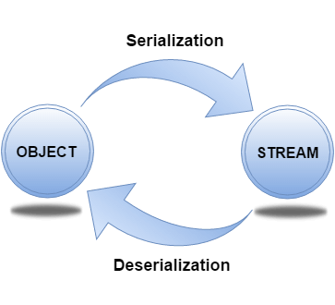
Serialization and Deserialization
Serialization in Java is a mechanism of writing the state of an object into a byte-stream.
It is mainly used in Hibernate, RMI, JPA, EJB and JMS technologies.
The reverse operation of serialization is called deserialization where byte-stream is converted into an object.
The serialization and deserialization process is platform-independent, it means you can serialize an object on one platform and deserialize it on a different platform.
For serializing the object, we call the writeObject() method of ObjectOutputStream class, and for deserialization we call the readObject() method of ObjectInputStream class.
We must have to implement the Serializable interface for serializing the object.
Advantages of Java Serialization
It is mainly used to travel object's state on the network (that is known as marshalling).

Slide 151
java.io.Serializable interface
Serializable is a marker interface (has no data member and method).
It is used to "mark" Java classes so that the objects of these classes may get a certain capability.
The Cloneable and Remote are also marker interfaces.
The Serializable interface must be implemented by the class whose object needs to be persisted.
The String class and all the wrapper classes implement the java.io.Serializable interface by default.

Slide 152
Servlet
Servlet is server side technology which is used to handle the client request, Process the request and generate the dynamic response.
Server
A server is a software or hardware device that accepts and responds to requests made over a network by the client.
Types of Server :
1) Web Server:
Apache Tomcat ,glassfish ,jetty.
2)Application Server :
Jboss ,Weblogic ,IBM websphere
Server side Technologies :
JSP ,Spring or Spring Boot ,Struts or JSF ,PHP ,Python.
Container:
->servlet container
->JSP container
->Security container
->WebSocket container
->JNDI container
Server
(Tomcat)

Slide 153
Steps to Configure eclipse and Tomcat
Download eclipse and tomcat zip file.
Set runtime environment of tomcat in eclipse.
Add server in eclipse.

Slide 154
Hierarchy
Interface
Servlet
It defines Servlet Life Cycle Methods
Http Methods:
1.GET
2.HEAD
3.POST
4.PUT
5.DELETE
class
GenericServlet
When We Want to create protocol independent Servlet
request
response
class
Not contained
HttpServlet
It is used when we want http specific methods and request-response Object.
Note : We have to create one file i.e. “Deployment Descriptor” file i.e. “web.xml”

Slide 155
1.Servlet Interface
Servlet interface provides common behavior to all the servlets.
Servlet interface defines methods that all servlets must implement.
Servlet interface needs to be implemented for creating any servlet (either directly or indirectly).
It provides 3 life cycle methods that are used to initialize the servlet, to service the requests, and to destroy the servlet and 2 non-life cycle methods.

Slide 156
Methods of Servlet interface
Method | Description
public void init(ServletConfig config) | initializes the servlet. It is the life cycle method of servlet and invoked by the web container only once.
public void service(ServletRequest request,ServletResponse response) | provides response for the incoming request. It is invoked at each request by the web container.
public void destroy() | is invoked only once and indicates that servlet is being destroyed.
public ServletConfig getServletConfig() | returns the object of ServletConfig.
public String getServletInfo() | returns information about servlet such as writer, copyright, version etc.

Slide 157
2.GenericServlet class
GenericServlet class implements Servlet, ServletConfig and Serializable interfaces.
It provides the implementation of all the methods of these interfaces except the service method.
GenericServlet class can handle any type of request so it is protocol-independent.

Slide 158
Methods of GenericServlet class
public void init(ServletConfig config) is used to initialize the servlet.
public abstract void service(ServletRequest request, ServletResponse response) provides service for the incoming request. It is invoked at each time when user requests for a servlet.
public void destroy() is invoked only once throughout the life cycle and indicates that servlet is being destroyed.
public ServletConfig getServletConfig() returns the object of ServletConfig.
public String getServletInfo() returns information about servlet such as writer, copyright, version etc.
public void init() it is a convenient method for the servlet programmers, now there is no need to call super.init(config)
public ServletContext getServletContext() returns the object of ServletContext.
public String getInitParameter(String name) returns the parameter value for the given parameter name.
public Enumeration getInitParameterNames() returns all the parameters defined in the web.xml file.
public String getServletName() returns the name of the servlet object.
public void log(String msg) writes the given message in the servlet log file.
public void log(String msg,Throwable t) writes the explanatory message in the servlet log file and a stack trace.

Slide 159
3. HttpServlet class
The HttpServlet class extends the GenericServlet class and implements Serializable interface.
It provides http specific methods such as doGet, doPost, doHead, doTrace etc.

Slide 160
Methods of HttpServlet class
public void service(ServletRequest req,ServletResponse res) dispatches the request to the protected service method by converting the request and response object into http type.
protected void service(HttpServletRequest req, HttpServletResponse res) receives the request from the service method, and dispatches the request to the doXXX() method depending on the incoming http request type.
protected void doGet(HttpServletRequest req, HttpServletResponse res) handles the GET request. It is invoked by the web container.
protected void doPost(HttpServletRequest req, HttpServletResponse res) handles the POST request. It is invoked by the web container.
protected void doHead(HttpServletRequest req, HttpServletResponse res) handles the HEAD request. It is invoked by the web container.
protected void doOptions(HttpServletRequest req, HttpServletResponse res) handles the OPTIONS request. It is invoked by the web container.
protected void doPut(HttpServletRequest req, HttpServletResponse res) handles the PUT request. It is invoked by the web container.
protected void doTrace(HttpServletRequest req, HttpServletResponse res) handles the TRACE request. It is invoked by the web container.
protected void doDelete(HttpServletRequest req, HttpServletResponse res) handles the DELETE request. It is invoked by the web container.
protected long getLastModified(HttpServletRequest req) returns the time when HttpServletRequest was last modified since midnight January 1, 1970 GMT.

Slide 161
Servlet Lifecycle
Loading and Instantiation :
When server is started ,servlet class is loaded in the memory & servlet object is Created.
Initialization : init()
Servlet object will be initialized by invoking init() method.
Request Handling : service()
It will handle or serve the client request. In this phase service() method will be invoked.
Destroy : destroy()
When the server is shutdown ,destroy() method will be executed & servlet object will be deleted.

Slide 162
Deployment Descriptor (web.xml)
Use:-
Servlet Configuration
JSP file Configuration
Filters Configuration
Listeners Configuration
Error Page Configuration
Welcome file Configuration etc.
We create file in WEB-INF folder.
NOTE:- In latest version, it is not compulsory to create web.xml.

Slide 163
Difference between GET and POST
GET method sends data through the resource URL.
POST method sends data through the HTTP message body.
GET is not secure as data visible in URL.
POST is more secured as data is not visible in URL.
We can send very less data using GET request because data is transferred using URL
We can send more data using POST because it does not send data using URL.

Slide 164
JAVA SERVER PAGES (JSP)
JSP is server Side Technology which is used to create dynamic web pages.
JSP is an advanced version of servlet Technology.
To embed java code in JSP ,We can use below tags :-
Scriptlet tag : <% some java code %>
Expression tag : <% =an expression %>
Declaration tag : <%! Variable declaration & method definition%>
Directive tag : <% @ directives %>
Comment tag : <%-any Text-%>
Action tag : <jsp : actionName/>

